Slide 1




Introduction To Computer Science
Dr/ Abdullah Nabil
Part 1

Slide 2
⬡What is Computer ?
Intro to Computer Science
Session outline :
⬡How Computers Work ?
⬡Decimal & Binary numbering systems.
⬡How computer stores Words (ASCII).
⬡ How computer stores Images.
⬡ How computer stores Videos.
⬡ How computer stores Audio.
⬡ How computer share information?

Slide 3
⬡What is Computer ?
Intro to Computer Science
Session outline :
⬡How Computers Work ?
⬡Decimal & Binary numbering systems.
⬡How computer stores Words (ASCII).
⬡ How computer stores Images.
⬡ How computer stores Videos.
⬡ How computer stores Audio.
⬡ How computer share information?
⬡ Jupyter Installation (Anaconda Based)

Slide 4


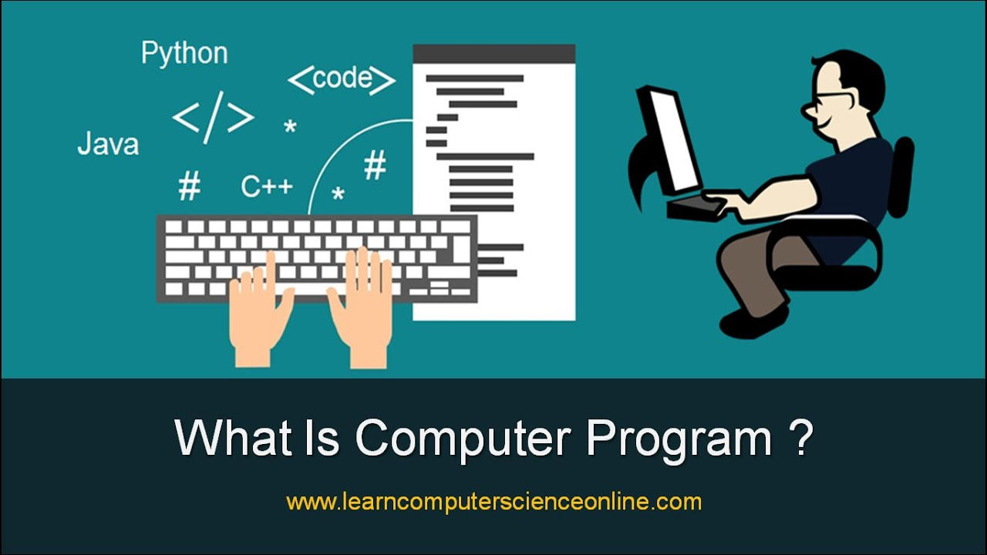
Intro to Computer Science
Computer Definition :
- A computer is a machine or device that performs processes, calculations and operations based on instructions provided by a software or hardware program
-The word "computer" was first used in 1613 in the book The Yong Mans Gleanings by Richard Braithwaite and originally described a human who performed calculations or computations.

Slide 5
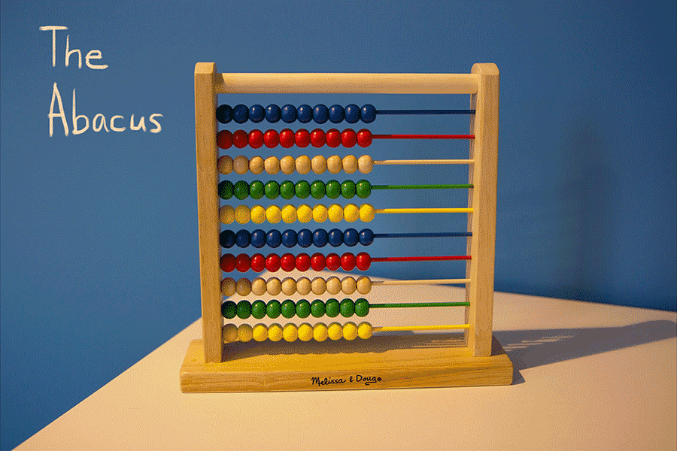
Intro to Computer Science
Abacus : First machine used in calculating

Slide 6
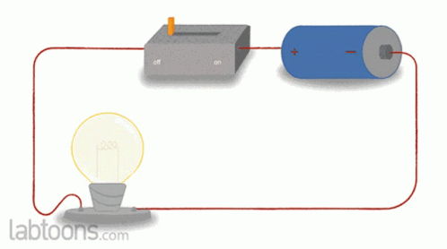


Electric circuit : After the discovery of electricity and the work of the first electrical circuit, the idea of ​​the computer wandered from a mechanical device to an electrical device :

Slide 7
Intro to Computer Science
All types of computers consist of two basic parts:
Hardware:
Is any part of your computer that has a physical structure, such as the computer monitor or keyboard.
Software:
Is any set of instructions that tells the hardware what to do.
It is what guides the hardware and tells it how to accomplish each task.
Some examples of software are web browsers, games, word processors, and operating systems.

Slide 8
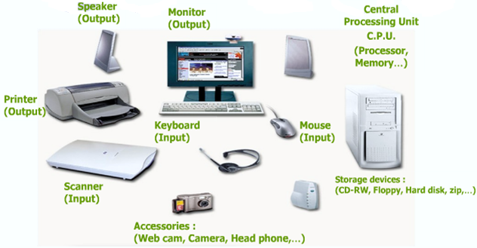
Hardware Hardware is any part of your computer that has a physical structure.

Slide 9
Software (OS)
An operating system is:
- The most important software that runs on a computer.
It manages the computer’s memory, processes
and all its software and hardware.
It also allows you to communicate with the computer
without knowing how to speak the computer’s "language." without an operating system, a computer is useless.

Slide 10
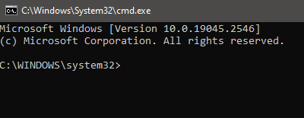
Disk Operating Systems (DOS)
Difference between DOS and Windows Operating Systems:
DOS uses CLI (command line interface), whereas Windows used GUI (graphical user interface).
Notes:
DIR
MKDIR
CD
EXIT
CLS

Slide 11
Disk Organization
how the hard disk is organized.
Files:
- A computer file is a block of arbitrary information, or resource for storing information, which is available to a computer program and is usually based on some kind of durable storage.
Computer files can be considered as the modern counterpart of paper documents which traditionally are kept in offices and libraries.
There are only two types of file operations: read and write.

Slide 12
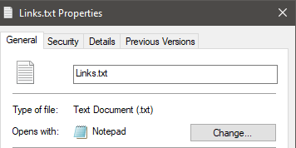
Filename Extension
Filename extension: is a suffix (separated from the base file name by a dot) to the name of a computer file applied to indicate the encoding (file format) of its contents or usage.
Examples:
MP3 - MPEG Audio Layer 3.
PDF - Portable Document File by Adobe.
TXT - Text Format.

Slide 13
Folders
Just like real world folders, folders on your hard drive store files.
These files can be documents, programs, scripts, libraries, and any other kind of computer file you can think of.
Folders can also store other folders, which may store more files or other folders, and so on.

Slide 14
⬡What is Computer ?
Intro to Computer Science
Session outline :
⬡How Computers Work ?
⬡Decimal & Binary numbering systems.
⬡How computer stores Words (ASCII).
⬡ How computer stores Images.
⬡ How computer stores Videos.
⬡ How computer stores Audio.
⬡ How computer share information?
⬡ Jupyter Installation (Anaconda Based)

Slide 15

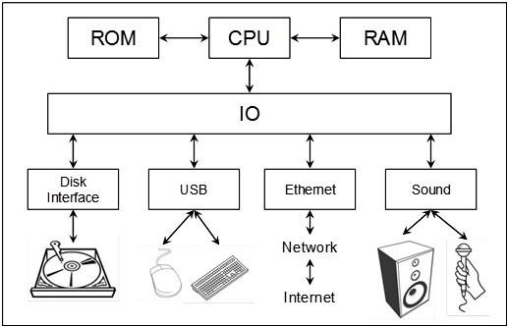
How Computers Work

Slide 16
⬡What is Computer ?
Intro to Computer Science
Session outline :
⬡How Computers Work ?
⬡Decimal & Binary numbering systems.
⬡How computer stores Words (ASCII).
⬡ How computer stores Images.
⬡ How computer stores Videos.
⬡ How computer stores Audio.
⬡ How computer share information?
⬡ Jupyter Installation (Anaconda Based)

Slide 17
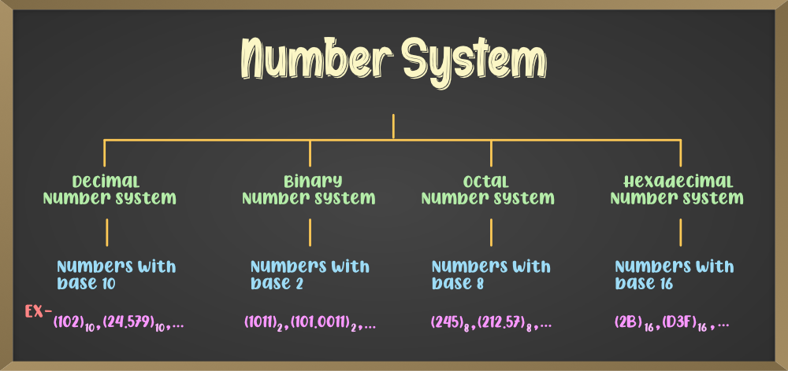
Number Systems: A system representing numbers

Slide 18


The Decimal Number System
Name : decimal
Base ( 10 ) system # numbers that consists of
Characteristics : Ten symbols 0 1 2 3 4 5 6 7 8 9
2945 = (2*${10}^{3}$) + (9*${10}^{2}$) + (4*${10}^{1}$) + (5*${10}^{0}$)
For an n-digit number, the value that each digit represents depends on its weight or position.
The weights are based on powers of 10
1024 = = 1000 + 20 + 4
(1*${10}^{3}$) + (0*${10}^{2}$) + (2*${10}^{1}$) + (4*${10}^{0}$)

Slide 19

The Binary Number System
Name : Binary
Base ( 2 ) system
Characteristics : Two symbols 0 1
Most (digital) computers use the binary number system
Terminology:
Bit: a binary digit
Byte: (typically) 8 bits
For an n-digit number, the value of a digit in each column depends on its position.
The weights are based on powers of 2.
(1011)2 = = 8 + 2 + 1 = (11)10
(1*$2^{3}$) + (0*$2^{2}$) + (1*$2^{1}$) + (1*$2^{0}$)

Slide 20


number of Bits needed to represent value
How many values can be represented in n bits ??
If n = 5 …
So the rule is ($2^{n}$)
So in 5 bits we can represent ($2^{5}$) = 32 value (00000 to 11111) in decimal is (0 to 31).
Largest & smallest number that can represented in n digits
If n = 5 …
So the rule of the largest value is ($2^{n}$ - 1)
So in 4 bits the largest value is ($2^{5}$ - 1)= (11111)2 in decimal (31)
And always the Smallest value is 0
So the smallest value is (00000)2 in decimal (0)

Slide 21
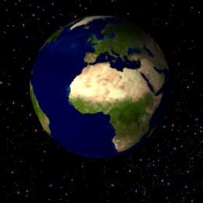
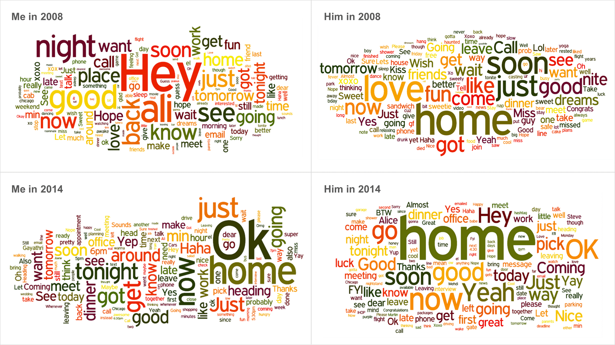

Intro to Computer Science
What is the unit of measurement for information? 🤔
Image
Text
Video

Slide 22
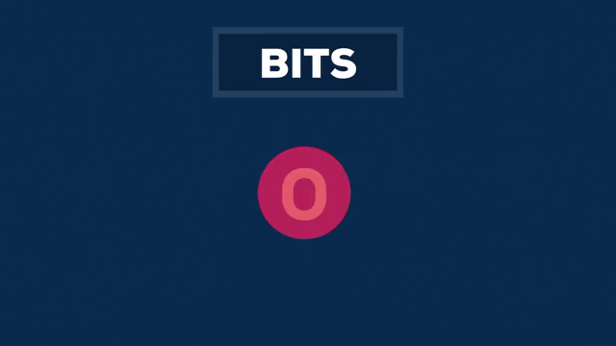
Data units
- The bit is the most basic unit of information in computing and digital communications.

Slide 23
⬡What is Computer ?
Intro to Computer Science
Session outline :
⬡How Computers Work ?
⬡Decimal & Binary numbering systems.
⬡How computer stores Words (ASCII).
⬡ How computer stores Images.
⬡ How computer stores Videos.
⬡ How computer stores Audio.
⬡ How computer share information?
⬡ Jupyter Installation (Anaconda Based)

Slide 24

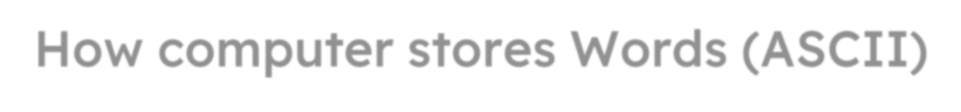
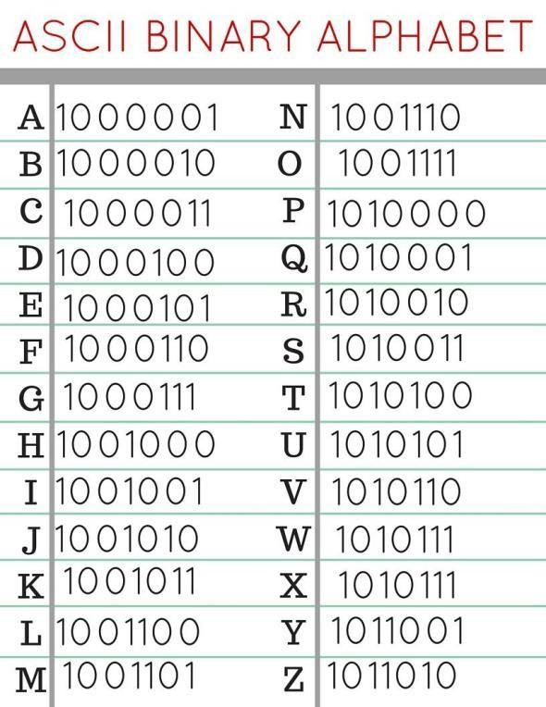


How computer stores Words (ASCII)
Full Table
http://www.asciitable.com/

Slide 25
⬡What is Computer ?
Intro to Computer Science
Session outline :
⬡How Computers Work ?
⬡Decimal & Binary numbering systems.
⬡How computer stores Words (ASCII).
⬡ How computer stores Images.
⬡ How computer stores Videos.
⬡ How computer stores Audio.
⬡ How computer share information?
⬡ Jupyter Installation (Anaconda Based)

Slide 26

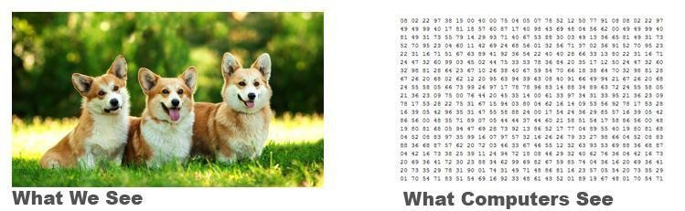
How computer stores Images
- An image is an array of numbers

Slide 27
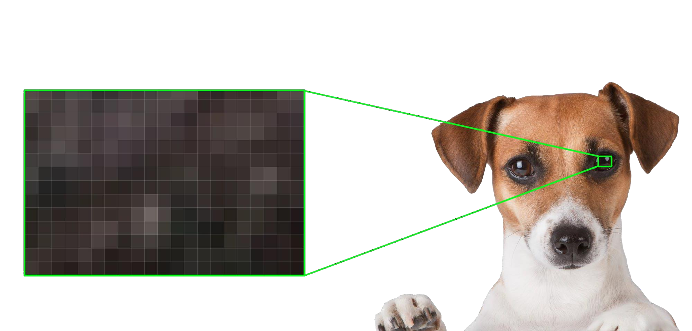




How computer stores Images
- Each number is considered a pixel
Pixels
Every pixel is one color
Height
Width

Slide 28


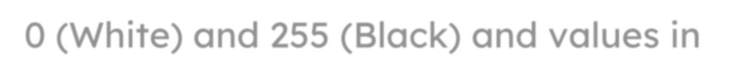

How computer stores Images
Grayscale Digital Images
We can generate a grayscale image by using Pixels each pixel has a single value between 0 (White) and 255 (Black) and values in between are gray variations.

Slide 29



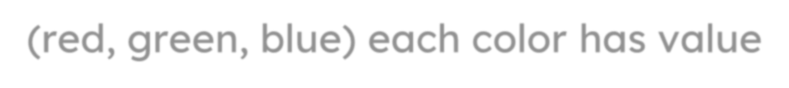
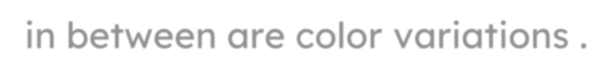
How computer stores Images
RGB Digital Images
We can generate an RGB image by using Pixels each pixel has 3 values for each color (red, green, blue) each color has value between 0 (Dark) and 255 (Light) and values in between are color variations .

Slide 30
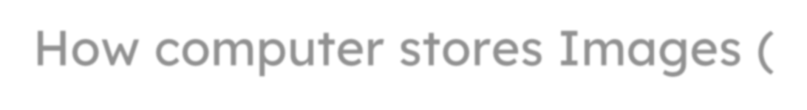


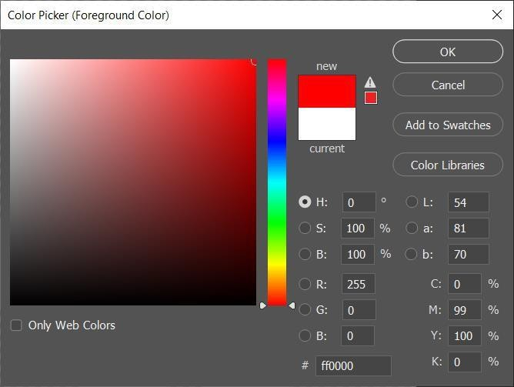
How computer stores Images (Red)

Slide 31

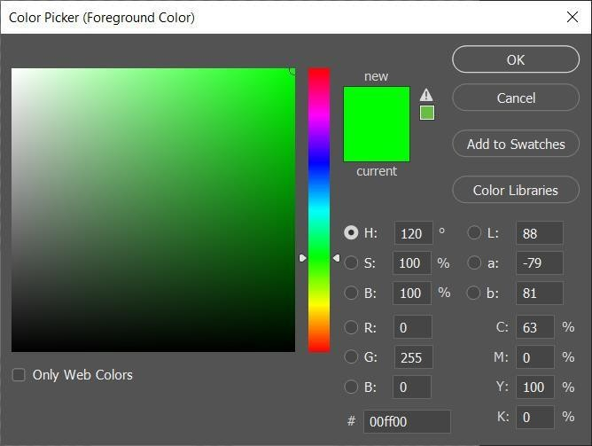
How computer stores Images (Green)

Slide 32
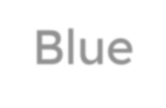

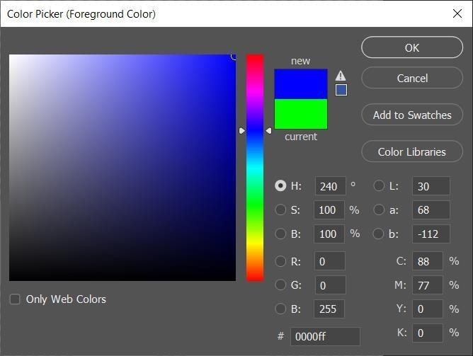
How computer stores Images (Blue)

Slide 33
Intro to Computer Science
QUIZ
What is the result if R=0, G=0, B=0 ?
A-
Black
White
Error
B-
C-

Slide 34
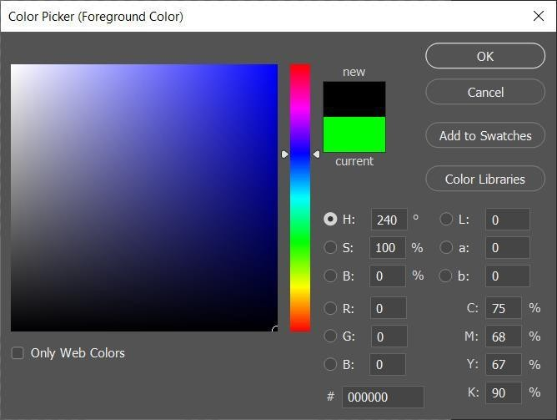
How computer stores Images (Black)

Slide 35

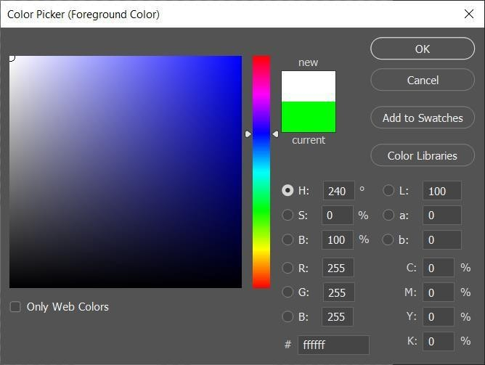
How computer stores Images (White)

Slide 36

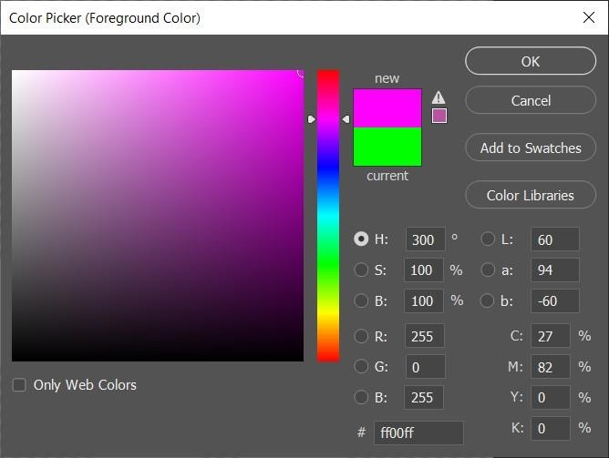
How computer stores Images (Pink)

Slide 37

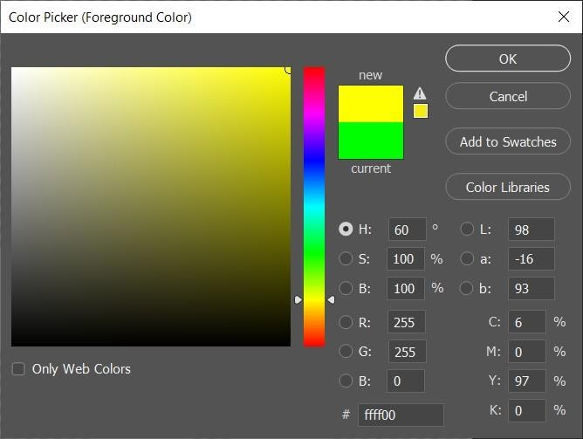
How computer stores Images (Yellow)

Slide 38
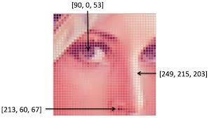



How computer stores Images
Resolution: 100x100
Width : 100 pixels
Height: 100 pixels

Slide 39
⬡What is Computer ?
Intro to Computer Science
Session outline :
⬡How Computers Work ?
⬡Decimal & Binary numbering systems.
⬡How computer stores Words (ASCII).
⬡ How computer stores Images.
⬡ How computer stores Videos.
⬡ How computer stores Audio.
⬡ How computer share information?
⬡ Jupyter Installation (Anaconda Based)

Slide 40


How computer stores Videos
- Videos is any digital moving picture .

Slide 41


Videos Quality
FPS "Frames Per Second" is used to measure frame rate – the number of consecutive full-screen images that are displayed each second.

Slide 42
⬡What is Computer ?
Intro to Computer Science
Session outline :
⬡How Computers Work ?
⬡Decimal & Binary numbering systems.
⬡How computer stores Words (ASCII).
⬡ How computer stores Images.
⬡ How computer stores Videos.
⬡ How computer stores Audio.
⬡ How computer share information?
⬡ Jupyter Installation (Anaconda Based)

Slide 43
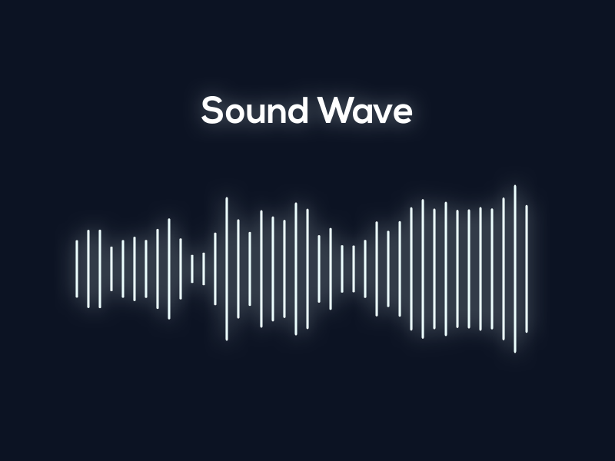
How computer stores Audio
- It’s get converted to 0s and 1s, it is recorded using a microphone which converts it to electrical signals in analogue form which are then converted to a digital (or binary) format using an A/D converter

Slide 44
⬡What is Computer ?
Intro to Computer Science
Session outline :
⬡How Computers Work ?
⬡Decimal & Binary numbering systems.
⬡How computer stores Words (ASCII).
⬡ How computer stores Images.
⬡ How computer stores Videos.
⬡ How computer stores Audio.
⬡ How computer share information?
⬡ Jupyter Installation (Anaconda Based)

Slide 45

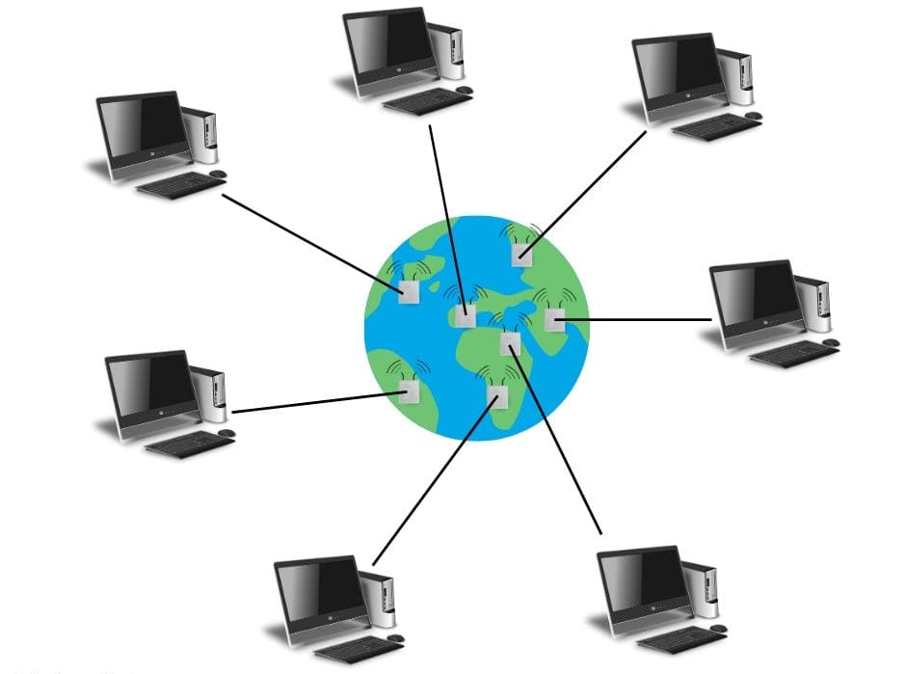
Network definition : A network is a collection of computers or other devices connected to one another to allow the sharing of data. An example of a network is the Internet, which connects millions of people all over the world.
Intro to Computer Science

Slide 46
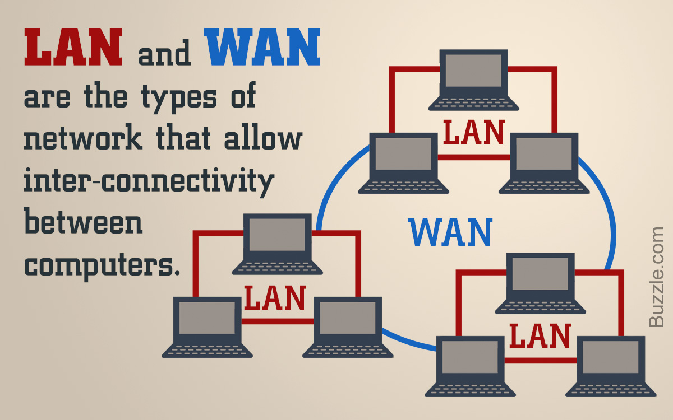
Network Types:
Intro to Computer Science
Notes:
(LAN)Local Area Network Covers a smaller geographic area, typically within a single building, office, or campus. It's used for connecting computers and devices in close proximity to each other.
(WAN) Wide Area Network Covers a larger geographic area, often spanning across cities, countries, or even continents. It connects multiple LANs and other network types over a broader region.

Slide 47
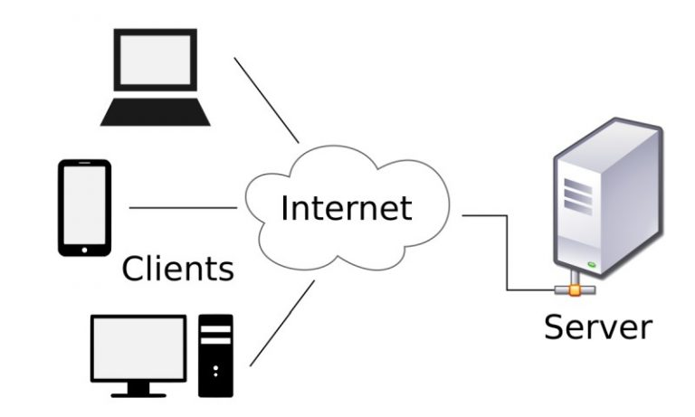
Client VS Server : - A server is a sample of software or hardware that serves a specific service to its clients. - A client is a user program that connects to a server to access a service.
Intro to Computer Science

Slide 48
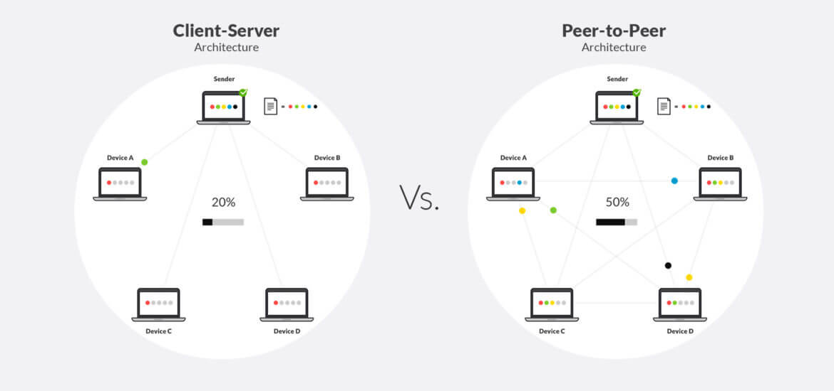
Network (shared information way):
Intro to Computer Science

Slide 49
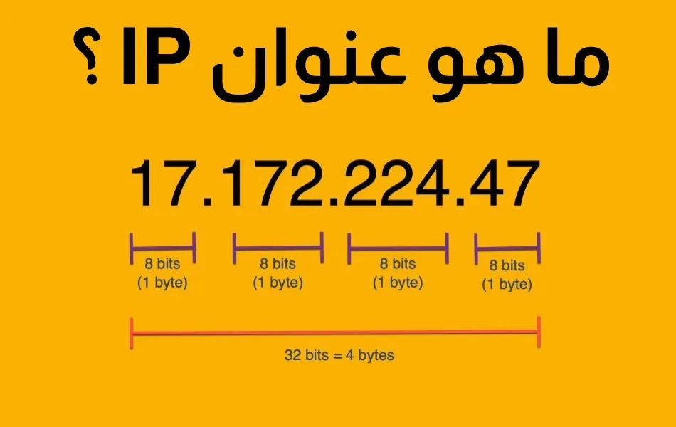
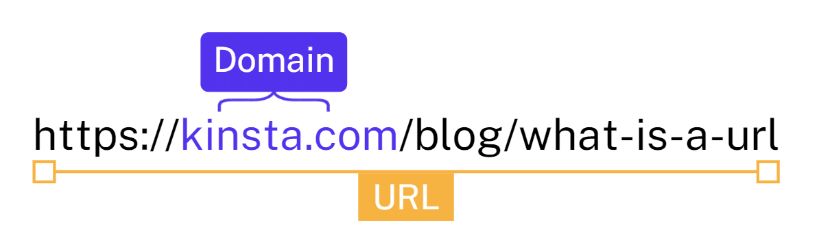
Important terms : 1. IP address (Internet Protocol) - Is a unique address that identifies a device on the internet or a local network. 2. URL (Uniform Resource Locator) -Is a reference (an address) to a resource on the Internet.
Intro to Computer Science

Slide 50
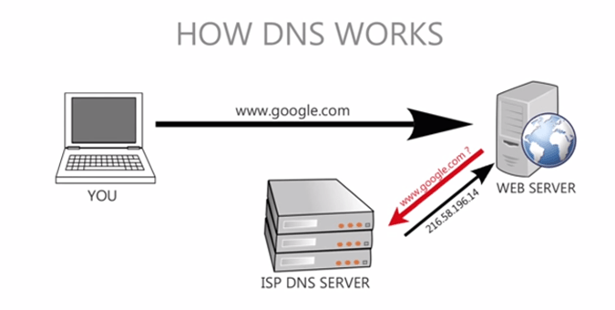

Important definitions : 3. DNS Server (Domain Name System) - Turns domain names into IP addresses. - Convert URL to IP address 4. ISP ( Internet service provider) - A company that provides consumers and businesses access to the Internet.
Intro to Computer Science

Slide 51
⬡What is Computer ?
Intro to Computer Science
Session outline :
⬡How Computers Work ?
⬡Decimal & Binary numbering systems.
⬡How computer stores Words (ASCII).
⬡ How computer stores Images.
⬡ How computer stores Videos.
⬡ How computer stores Audio.
⬡ How computer share information?
⬡ Jupyter Installation (Anaconda Based)

Slide 52

Anaconda & Jupyter Installation - Anaconda: is a tool that offers all the required tools involved in data science at once. - Jupyter: Notebook provides you with an easy-to-use, interactive data science environment across many programming languages
Intro to Computer Science

Slide 53
Download Anaconda
Intro to Computer Science
Windows: https://docs.anaconda.com/anaconda/install/windows/
macOS: https://docs.anaconda.com/anaconda/install/mac-os/
Linux: https://docs.anaconda.com/anaconda/install/linux/

Slide 54
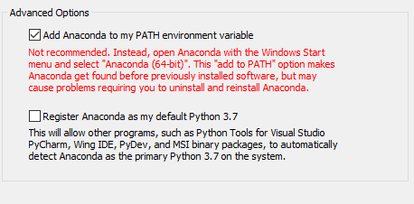
Install Anaconda The wizard is simple to use, only make sure that you added Anaconda to the $PATH environment variable by checking that option during the installation Check both options if you need Anaconda to manage your Python installation.
Intro to Computer Science

Slide 55
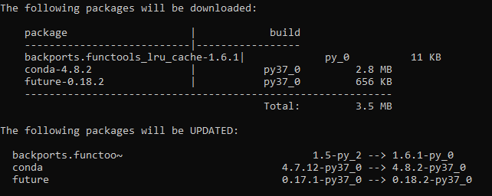
Install Anaconda (cont.) -If you have Anaconda already installed, just keep things up to date by issuing this command -If the package management module found that there are some update it will list them for you then let you either to proceed with the update or stay on old versions. Proceed with the update by typing “y”.
Intro to Computer Science

Slide 56
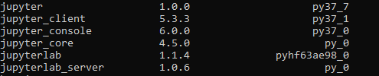
Install Anaconda (cont.) -if we want to verify that Jupyter is installed, we can do this by issuing: -To search for Jupyter packages inside the listing. You should have something similar to this: -To start Jupyter server using this command:
Intro to Computer Science

Slide 57
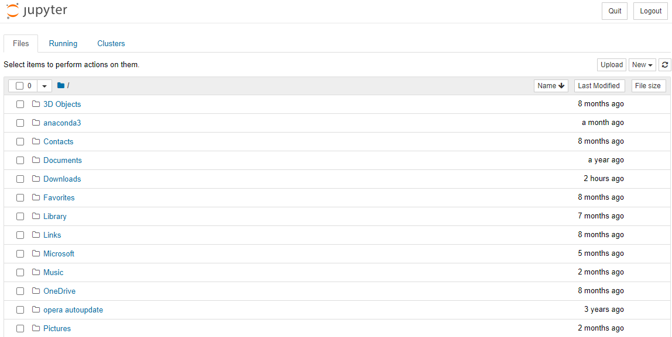
Install Anaconda (cont.) - A new browser tab will be opened for you containing directories and files (depending on the directory from which you issued the command)
Intro to Computer Science

Slide 58
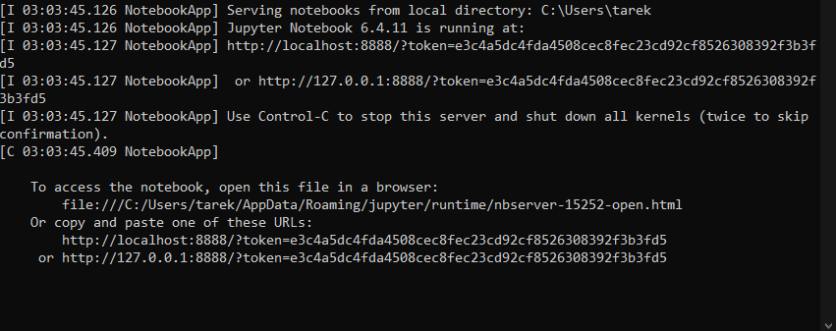
Install Anaconda (cont.) To verify that things are working, you should see a server log like this:
Intro to Computer Science

Slide 59
Questions ?!

Slide 60
Thanks!

